Slide 1
Title
Name
Date

Slide 2
Slide 1 Title
Points
More points

Slide 3
Slide Examples

Slide 4


Why Mobile?
>
15 Billion Mobile Devices
https://www-statista-com.eu1.proxy.openathens.net/statistics/245501/multiple-mobile-device-ownership-worldwide/
https://www.statista.com/statistics/273495/global-shipments-of-personal-computers-since-2006/

Slide 5



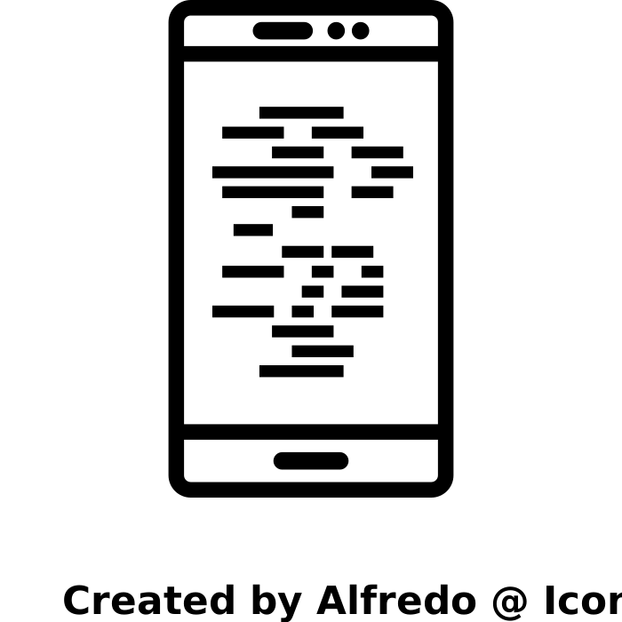



Detecting Malware
Official and alternative stores
On-device protection
Antivirus companies
Companies whose apps are impersonated by malicious apps (e.g., Meta/WhatsApp)
…
+
+
Static Analysis
Dynamic Analysis
Machine Learning

Slide 6
Detecting Malware
Official and alternative stores
On-device protection
Antivirus companies
Companies whose apps are impersonated by malicious apps (e.g., Meta/WhatsApp)
…
+
+
☹
Static Analysis
Dynamic Analysis
Machine Learning

Slide 7

Why is this happening?

Slide 8


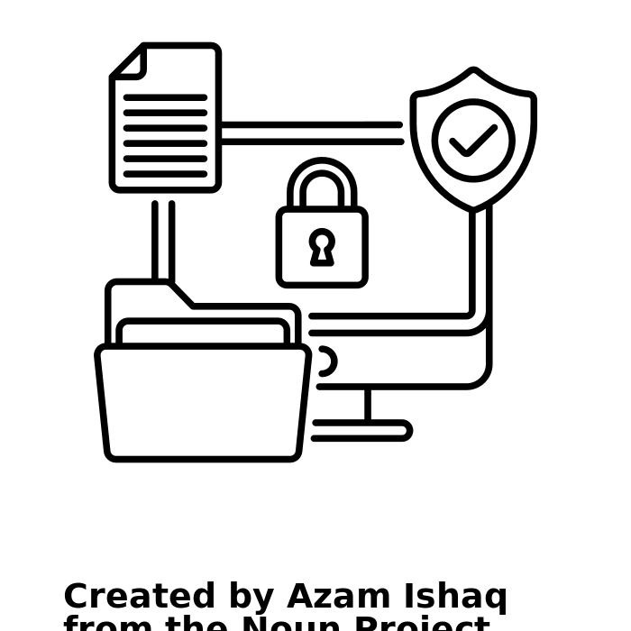



A Collection of Recent Malware
…
Alternative Markets
Virus Repositories
Historical Repositories
Security Companies
Security Posts
Android Repositories
1,238 apps, 134 families
105 families analyzed
[1] Michael Cao, Khaled Ahmed, and Julia Rubin. Rotten Apples Spoil the Bunch: an Anatomy of Google Play Malware, ICSE 2022.

Slide 9
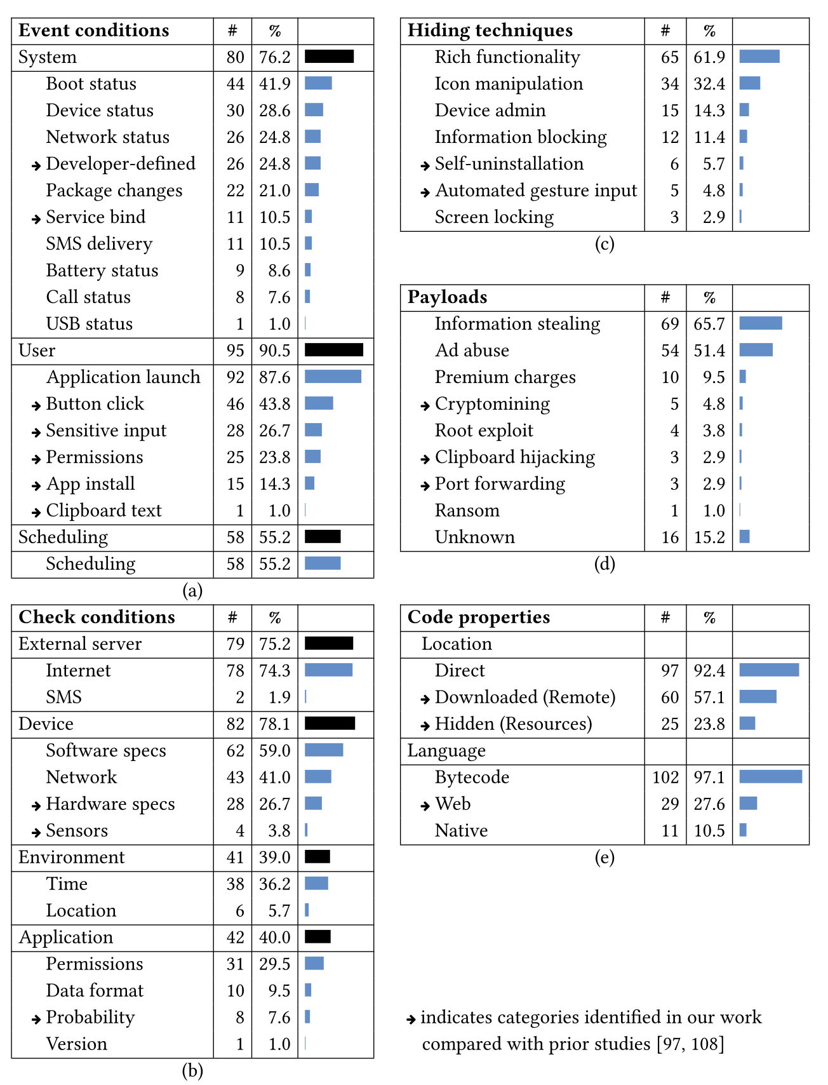
Characterization Schema
Initial entry point of malicious path
Guarding conditions along malicious path
Main malicious behavior
Implementation
location and language
Hide maliciousness from user

Slide 10
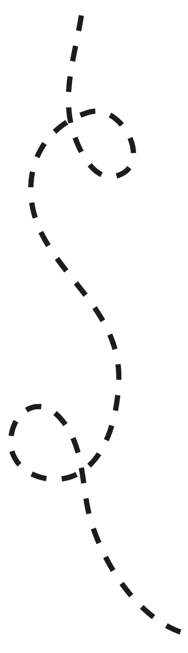
Event and Check Conditions
1/3 of the payloads are not triggered on app launch
A variety of checks that guard the malicious payload, e.g., execute if
accelerometer data implies real device
a certain app is opened
at random
App Launch
Network Status Change
Event C.
Event C.
accelerometer data
bank app installed
rand > 25
Payload
Payload

Slide 11

Cross-path Dependencies
Order of events matters
Payload is executed only if events are triggered in a certain order
App Launch
Network Status Change
2
1
Event C.
Event C.
Data dependency
via shared pref.
Check C.
Data R.
Check C.
Cross-path data dependency
(40% of apps)
Check C.
Payload
Payload

Slide 12
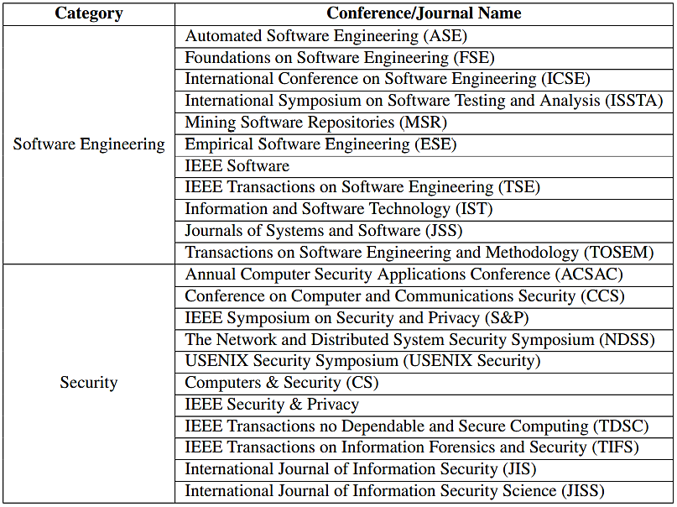
Tool Collection
Goal: Understand gaps in existing defenses
Top conferences and journals
Between 2010 – 2021
Seven Android security surveys
Between 2015 – 2020
237 papers in total
[1] Michael Cao, Khaled Ahmed, and Julia Rubin. Rotten Apples Spoil the Bunch: an Anatomy of Google Play Malware, ICSE 2022.

Slide 13
Tool Categorization
Generic Malware (110)
Payload-specific (51)
Condition Detection (3)
Forced Execution (7)
Malware Detection Tools
Hiding Detection (4)
Sandboxing (14)
Dynamic Code Loading (2)
Inter-app Attack (26)
Repackaged Malware (9)

Slide 14
Tool Categorization
Extract generic features separating benign and malware samples
E.g., DREBIN [*] features
Android components
Permissions
API calls
Network addresses
Generic Malware (110)
Payload-specific (51)
Condition Detection (3)
Forced Execution (7)
Malware Detection Tools
Hiding Detection (4)
Sandboxing (14)
Dynamic Code Loading (2)
Inter-app Attack (26)
Repackaged Malware (9)
[*] Daniel Arp, Michael Spreitzenbarth, Malte Hubner, Hugo Gascon, and Konrad Rieck. "Drebin: Effective and explainable detection of android malware in your pocket." In NDSS, vol. 14, pp. 23-26. 2014.

Slide 15
Why Does Malware Evade Detection?
Static Analysis
Cannot reason about dynamically-loaded and obfuscated code Hard to scale for real apps
Dynamic Analysis
Cannot reach hard-to-trigger code
ML-based Detection
Not reliable and not explainable
[4] Michael Cao, Sahar Badihi, Khaled Ahmed, Peiyu Xiong, and Julia Rubin. On Benign Features in Malware Detection. ASE 2020, NIER Track.

Slide 16



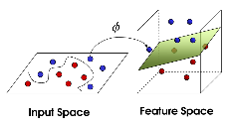




Case Study
Training Set (2016-2017)
DREBIN Features
Reasons
Android Manifest:
- Requested Permissions
- Hardware
- Components
Bytecode:
- API calls
- IP addresses
- Used permissions
Classifier
Testing Set (2018-2019)
SVM
[4] Michael Cao, Sahar Badihi, Khaled Ahmed, Peiyu Xiong, and Julia Rubin. On Benign Features in Malware Detection. ASE 2020, NIER Track.
Notes:
For our case study, we selected data commonly used in the evaluation of previous techniques. More specifically, we collected benign samples from Google Play and malware samples from VirusTotal Academic edition between the years 2016 and 2019.
We picked features from a popular malware detection tool, Drebin, because it extracts a variety of features from both the Android manifest file and application bytecode. Drebin also outperforms several existing tools even in the most recent studies.
To create a realistic experimental setup, we trained a support vector machine classifier with DREBIN’s features on samples from 2016 and 2017 and produced a classifier model.
We used samples from 2018 and 2019 for testing.

Slide 17



On-Device Malware Detection
Remove from store and user devices
Dynamic on-device analysis
User devices
Requirements:
1. Efficient: no visible slowdown or battery life degradation
2. Explainable: help the analyst to verify the malicious behavior

Slide 18

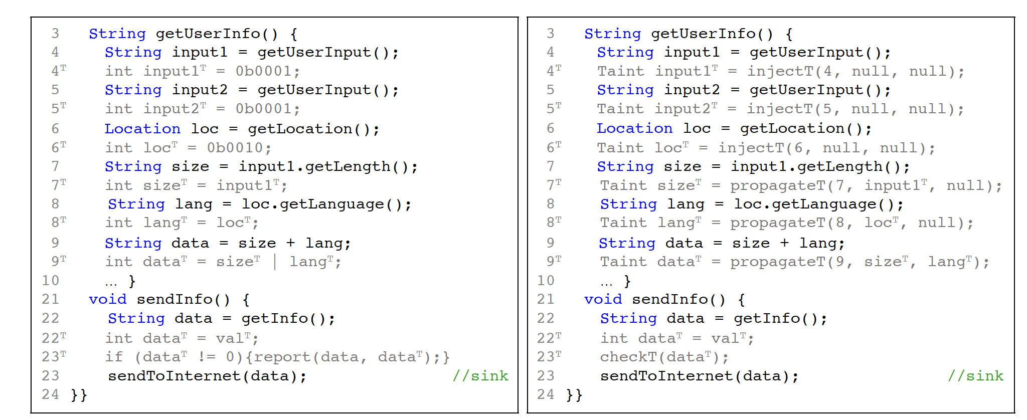
Our Path-Aware Dynamic Taint Analysis for Android
Taint marking (one bit per taint)

Slide 19
Our Path-Aware Dynamic Taint Analysis for Android
Taint marking (one object per taint)

Slide 20
Our Path-Aware Dynamic Taint Analysis for Android
input1^{T}
size^{T}
#4
#7
p1
p1
p2
p2
data^{T}
data^{T}
#10
#22
input2^{T}
data^{T}
p1
p1
#5
#9
p2
p2
p1
p1
p2
p2
this.info^{T}
val^{T}
loc^{T}
lang^{T}
#15
#18
#6
#8
p1
p1
p1
p1
p2
p2
p2
p2

Slide 21
Our Path-Aware Dynamic Taint Analysis for Android
input1^{T}
size^{T}
#4
#7
p1
p1
p2
p2
data^{T}
data^{T}
#10
#22
input2^{T}
data^{T}
p1
p1
#5
#9
p2
p2
p1
p1
p2
p2
this.info^{T}
val^{T}
loc^{T}
lang^{T}
#15
#18
#6
#8
p1
p1
p1
p1
p2
p2
p2
p2
Tracks any number of taint sources
Reports all source to sink paths
Memory efficient: taints of out-of-scope objects are garbage collected

Slide 22







A Survey on the Effects of Data on Adversarial Robustness
Step 1: Paper Collection
ML + CV + CL + Security
18 A* conferences
16 top journals
4,429
papers
CORE ranking
JCR ranking
Step 2: Paper Selection
Discuss and draft selection criteria
40
papers
3,089
papers
Exclude
non-main track publications
and
duplicates
Validate and refine criteria
40
papers
Backward Snowballing
57
related
papers
54
related
papers
199
potential
papers
3,009
papers
Discussion
Independent
Notes:
For this process,
We first drafted the selection criteria using 40 papers randomly sampled from the pool.
On this set, each collaborator independently assigned include / exclude or unsure to the papers.
Then, we cross-validated our decisions and discussed a draft of selection criteria.
To validate the applicability of the designed selection criteria, we sampled another set of 40 papers.
Again we individually filtered the set, cross-validated our decisions, and then we discussed to refine the selection criteria.
After making sure we have similar standards regarding paper exclusion we distributed the remaining papers among collaborators to filter independently.
Through this process, we identified 199 potentially related papers.
And on this set of papers, we assigned a second reader to all the papers to cross validated the decision,
and for papers tagged as “unsure” or encountered conflict during cross validation, we held meetings with all collaborators to discuss for the final decision.
This process resulted in 54 relevant papers.
Finally, using related work sections of the selected papers, we also performed backward snowballing, which increased the total number of papers to 57.

Slide 23



Survey: Results
f2
f2
μ₁
μ₁
f1
f1
10/57
17/57
8/57
5/57
13/57
 | Number of samples | Dimensionality | Distribution | Density | Separation | Concentration | Label quality | Domain specific
What it is? | Distances between samples from different classes to each other (inter-class distance)
Main results | Larger separation leads to lower adversarial vulnerability Distance metrics, e.g., optimal transport, characterize the lower bound Large separation makes some local classifiers (e.g., 1-NN) naturally robust Increasing the separation of internal (latent) features improves robustness

Slide 24
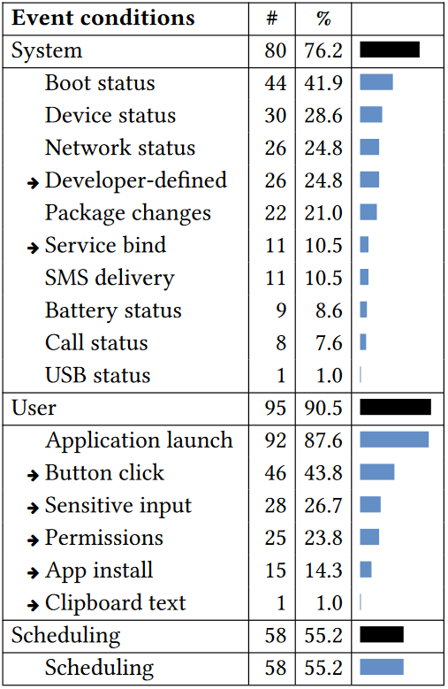
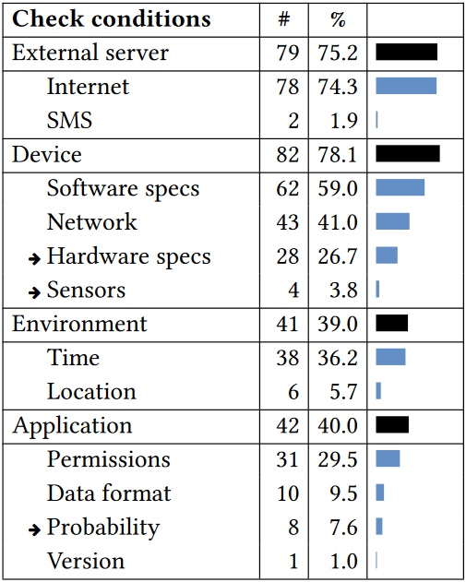
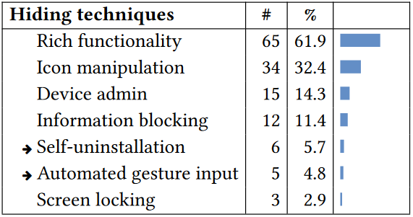


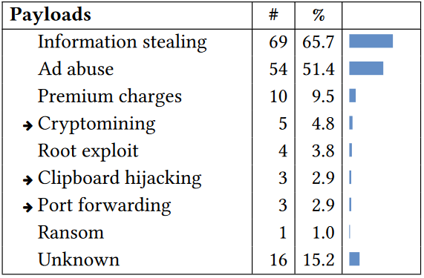
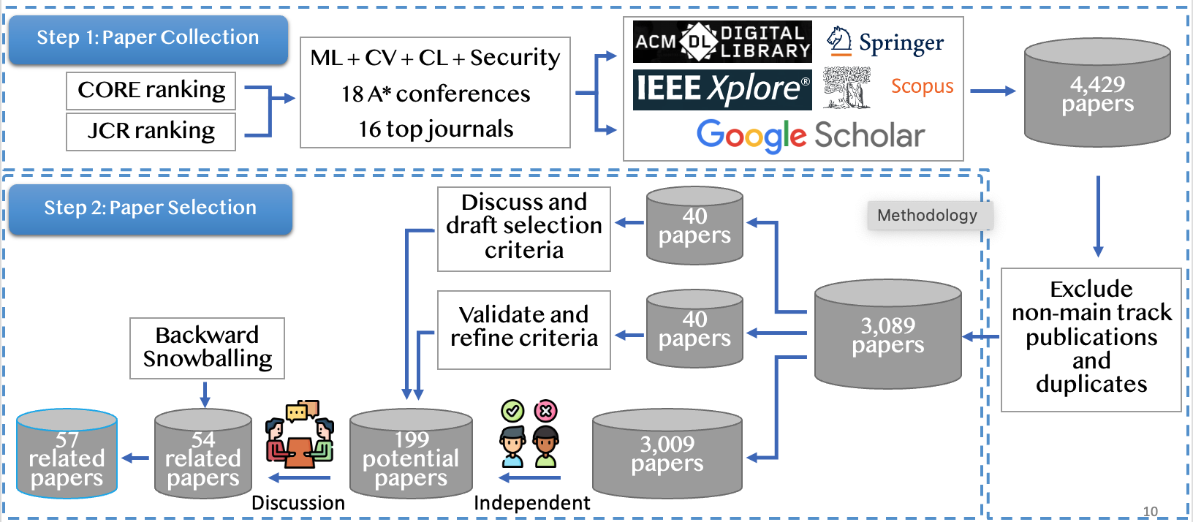

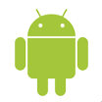



Summary
Contact info: mjulia@ece.ubc.ca
Evasive Malware
Static Analysis
Cannot reason about dynamically-loaded and obfuscated code Hard to scale for real apps
Dynamic Analysis
Cannot reach hard-to-trigger code
ML-based Detection
Not reliable and not explainable
Path-aware Dynamic Taint Analysis
Data Properties for ML Robustness
input1^{T}
size^{T}
#4
#7
p1
p1
data^{T}
data^{T}
p2
p2
#10
#22
input2^{T}
data^{T}
p1
p1
#5
#9
p2
p2
p1
p1
Tracks any number of taint sources
Reports all source to sink paths
Memory efficient: taints of out-of-scope objects are garbage collected
p2
p2
this.info^{T}
val^{T}
loc^{T}
lang^{T}
#15
#18
#6
#8
p1
p1
p1
p1
p2
p2
p2
p2
Current work
On device detection
Feature, data, and learning representation

Slide 25
BACKUP

